Slide 1
Effortless Distributed Computing in Python
IAstro – Porto – July 2026
Raphael J.
https://raphaelj.be

Slide 2
👋 Nice to meet you
Raphael from Belgium 🇧🇪
Freelance computer scientist
Past 2y+ working on new parallelization libraries for Python
  Incubated by the Linux Foundation (FINOS)
  Designed for scientists / mathematicians, not computer scientists
  🚧 Still under development (beta!)

Slide 3
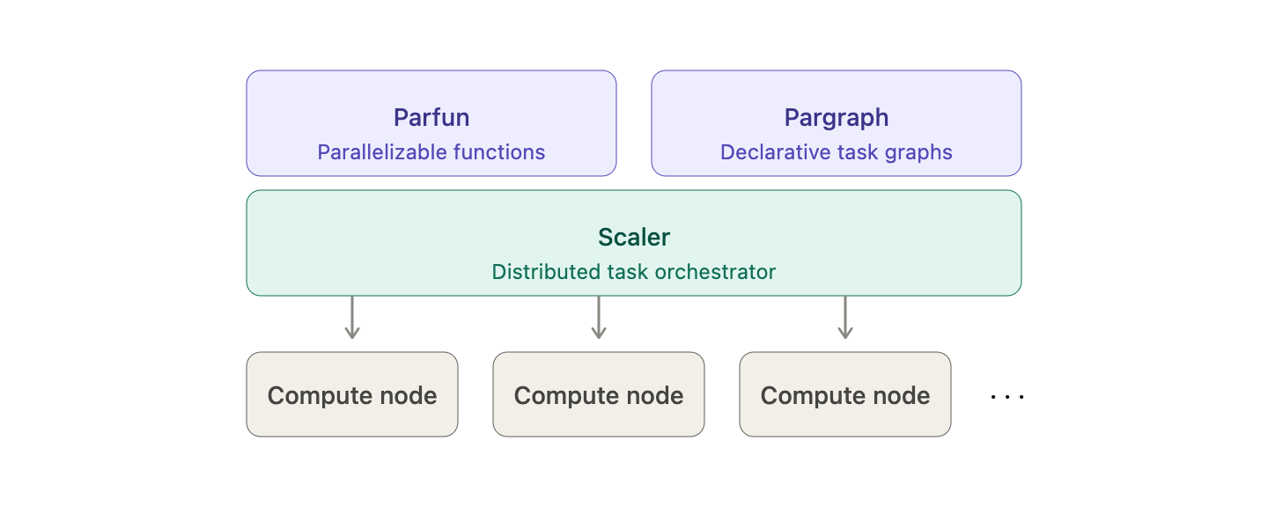
Menu
Parallel and distributed computing
What it is, why and how
Parfun
Parallel Python functions
Pargraph
Distributed computational graphs
Scaler
Leveraging multiple computers
Astrophysics experiment

Slide 4
Parallel and distributed computing
Parallel and distributed computing

Slide 5
Parallel and distributed computing
Computer science is sequential by default
def is_prime(n: int) -> bool:
if n < 2:
return False
for i in range(2, int(sqrt(n)) + 1):
if n % i == 0:
return False
return True
“Do this then do that”

Slide 6
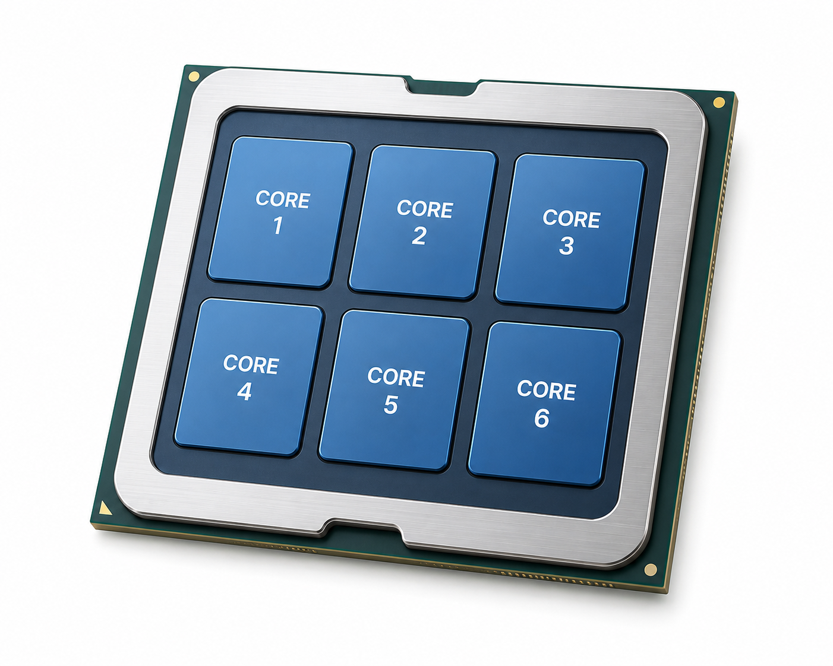

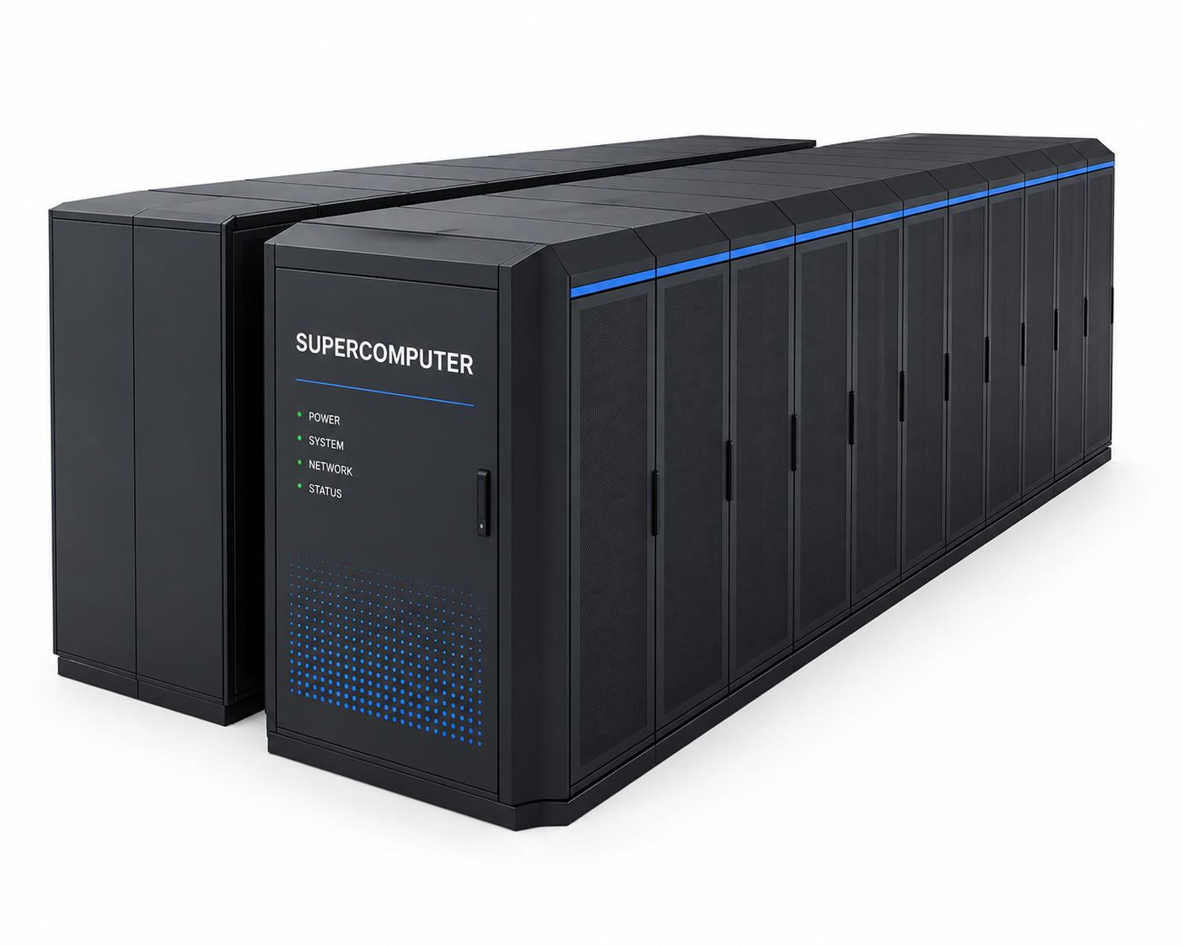
Parallel and distributed computing
Modern computers are massively parallel
Computer 4 to 64 cores | GPU 1,000+ cores | Supercomputer 150,000+ cores

Slide 7
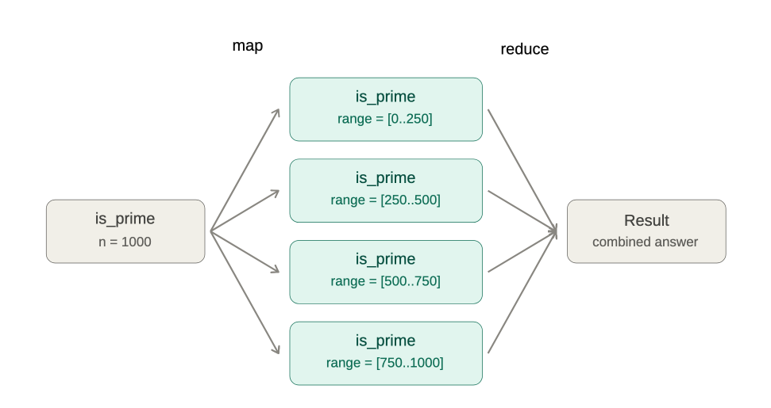
Parallel and distributed computing
Parallelizing by splitting the work

Slide 8
Parallel and distributed computing
def analyze_stellar_spectrum(stellar_data_path: str, reference_spectrum: str):
stellar_data = load_stellar_data(stellar_data_path)
spectrum = extract_spectrum(stellar_data)
emission_peaks = find_emission_peaks(spectrum)
reference = load_spectrum_reference_data(reference_name)
filtered_reference = select_relevant_frequencies(reference)
matches = match_emission_peaks(emission_peaks, filtered_reference)
return matches

Slide 9
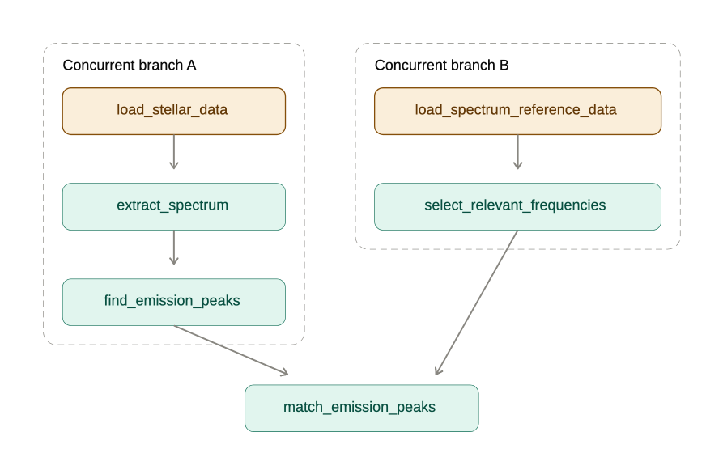
Parallel and distributed computing
Concurrent execution is possible

Slide 10
Parallel and distributed computing
Challenges
How to split the task
Sub-tasks must be independent (functional purity)
Orchestration / synchronization overhead
Computation efficiency vs synchronization efficiency
  Too low parallelism => low CPU usage
  Too much parallelism => low performances

Slide 11
Parfun
Parfun
Parallelize Python functions by splitting the input data
https://github.com/finos/opengris-parfun

Slide 12
Parfun – Count words in text
from collections import Counter
def count_words(text: List[str]) -> Counter:
counter = Counter()
for line in text:
for word in line.split():
counter[word] += 1
return counter
>>> count_words(open("small_text.txt").readlines())
Counter({'the': 117,
'and': 106,
'of': 90,
'to': 83,
'in': 42,
'right': 33,
...})

Slide 13
Parfun – Map reduce
Process
Input
Split
Process
Combine
Output
Process

Slide 14
Parfun – @parallel
import parfun as pf
@pf.parallel(
# Parallelize by splitting the file content
split=pf.per_argument(
lines=pf.py_list.by_chunk
),
# Sum the result counters
combine_with=sum,
)
def count_words(text: List[str]) -> Counter:
...
>>> count_words(open("very_large_file.txt").readlines())
Counter({'the': 11700,
...

Slide 15
Parfun – @parallel
import parfun as pf
@pf.parallel(
# Parallelize by splitting the file content
split=pf.per_argument(
lines=pf.py_list.by_chunk
),
# Sum the result counters
combine_with=sum,
)
def count_words(text: List[str]) -> Counter:
...
>>> count_words(open("very_large_file.txt").readlines())
Counter({'the': 11700,
...

Slide 16
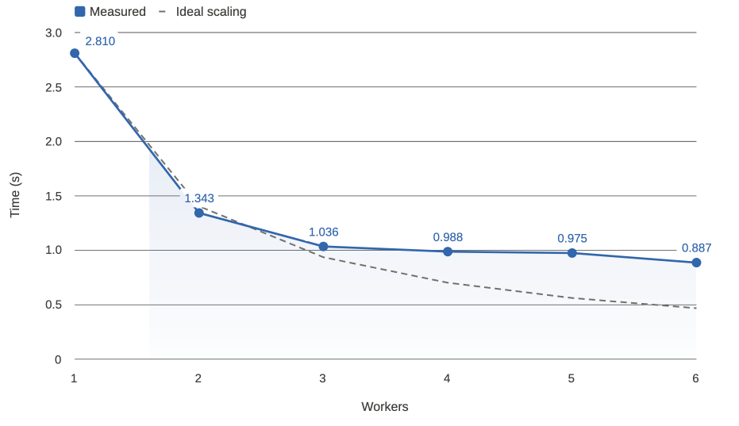
Parfun – Performances

Slide 17
Parfun – Find the optimal batch size
How to find the optimal sub-task size?
Text too small: overheads will large
  Communication, I/O, synchronization ...
Text too large: parallelism will be low

Slide 18
Parfun – Find the optimal batch size
Use Machine-Learning!
count_words()
total CPU execution time: 0:00:00.174216.
compute time: 0:00:00.165855 (95.20%)
min.: 0:00:00.017239
max.: 0:00:00.020540
avg.: 0:00:00.018428
total parallel overhead: 0:00:00.008361 (4.80%)
total partitioning: 0:00:00.006238 (3.58%)
average partitioning: 0:00:00.000693
total combining: 0:00:00.002123 (1.22%)
maximum speedup (theoretical): 8.48x
total partition count: 9
estimator state: running
estimated partition size: 1638

Slide 19
Pargraph
Pargraph
A declarative distributed graph engine
https://github.com/finos/opengris-pargraph/

Slide 20
Pargraph – Declarative graphs
def analyze_stellar_spectrum(stellar_data_path: str, reference_spectrum: str):
stellar_data = load_stellar_data(stellar_data_path)
spectrum = extract_spectrum(stellar_data)
emission_peaks = find_emission_peaks(spectrum)
reference = load_spectrum_reference_data(reference_name)
filtered_reference = select_relevant_frequencies(reference)
matches = match_emission_peaks(emission_peaks, filtered_reference)
return matches

Slide 21
Pargraph – Declarative graphs
def analyze_stellar_spectrum(stellar_data_path: str, reference_spectrum: str):
stellar_data = load_stellar_data(stellar_data_path)
spectrum = extract_spectrum(stellar_data)
emission_peaks = find_emission_peaks(spectrum)
reference = load_spectrum_reference_data(reference_name)
filtered_reference = select_relevant_frequencies(reference)
matches = match_emission_peaks(emission_peaks, filtered_reference)
return matches
Can run concurrently !

Slide 22
Pargraph – Declarative graphs

Slide 23
Pargraph – Declarative graphs
from pargraph import delayed, graph
@delayed
def load_stellar_data(data_path: str) -> np.array:
...
@delayed
def extract_spectrum(stellar_data: np.array) -> np.array:
...
@delayed
def find_emission_peaks(spectrum: np.array) -> np.array:
...
...
@graph
def analyze_stellar_spectrum(stellar_data_path: str, reference_spetrum: str):
...

Slide 24
Pargraph – Declarative graphs
from pargraph import delayed, graph
@delayed
def load_stellar_data(data_path: str) -> np.array:
...
@delayed
def extract_spectrum(stellar_data: np.array) -> np.array:
...
@delayed
def find_emission_peaks(spectrum: np.array) -> np.array:
...
...
@graph
def analyze_stellar_spectrum(stellar_data_path: str, reference_spectrum: str):
...
Leaf nodes
Parent node

Slide 25
Pargraph – Declarative graphs
>>> analyze_stellar_spectrum.to_graph().to_dot().write_png("graph.png")
>>> graph_engine.get(analyze_stellar_spectrum.to_graph(data_path=..., ...))

Slide 26
Scaler
Scaler
A distributed task scheduler
https://github.com/finos/opengris-scaler/

Slide 27
Scaler - Architecture

Slide 28
Scaler - Architecture
Worker
$ scaler_cluster -n 8
Client
Pargraph
Worker
Client
Parfun
Scheduler
Worker
...
...

Slide 29
Scaler – Setup
Installation
$ pip install opengris-scaler
Scheduler
$ scaler scaler_config.toml
Worker nodes
$ scaler_worker_manager baremetal_native "tcp://scheduler_address"

Slide 30
Scaler – Python client
# Parfun tasks
with pf.set_parallel_backend_context("scaler_remote", scheduler_address):
counts = count_words(my_very_long_text)
# Pargraph tasks
from pargraph import GraphEngine
from scaler import Client
graph_engine = GraphEngine(Client(scheduler_address))
graph = analyze_stellar_spectrum.to_graph()
graph_nodes, graph_keys = graph.to_dict(stellar_data_path="stellar_data.npz", spectrum_reference="spectrum_ref.npz")
graph_engine.get(graph_nodes, graph_keys)

Slide 31
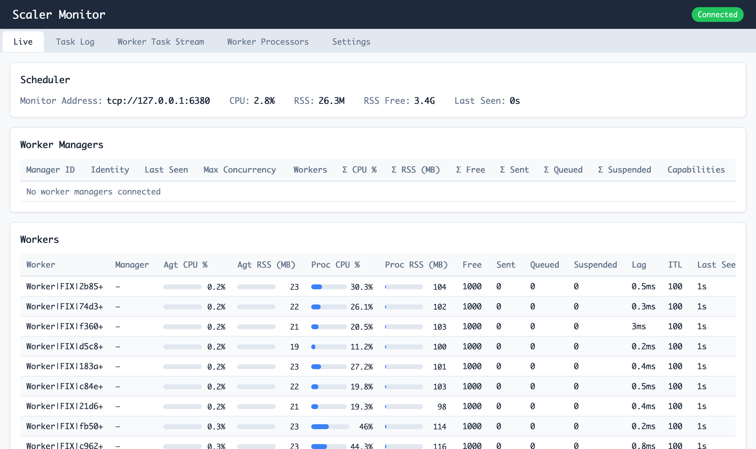
Scaler – Web monitor

Slide 32
Scaler – Failure recovery
Worker
$ scaler_cluster -n 8
Worker
Reroute
Scheduler
☠️
Reroute
Worker

Slide 33
Scaler – Dynamic load balancing
Worker
$ scaler_cluster -n 8
Worker
Reroute
Unassign
Scheduler
🥵
Reroute
Worker

Slide 34
Scaler – Warning
⚠️ Experimental -- under development
⌛️ Stable versions of Scaler, Parfun and Pargraph expected soon!

Slide 35
Astrophysics experiment
Astrophysics experiment

Slide 36
Thank you !
Q & A
Raphael J.
https://raphaelj.be

